Slide 1

PaaS
EPL421: Systems Programming
By: Loukia Ioannou (lioann02@ucy.ac.cy),
Ioannis Constantinou (iconst01@ucy.ac.cy),
Georgia Christou (gchris08@cs.ucy.ac.cy)

Slide 2
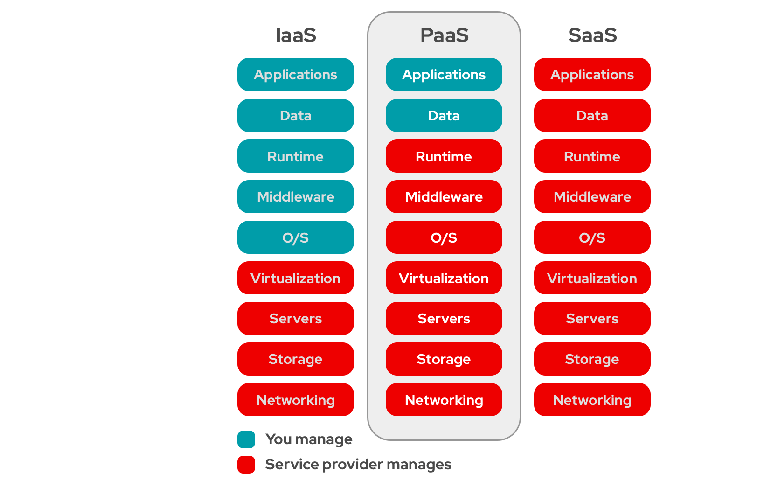
What is PaaS?
Platform as a (Cloud) Service
Provides a framework for software creation
Focus remains on developing the app, not on managing resources or maintaining the infrastructure
Reduced Costs 👍
Simplicity 👍
Faster Development 👍
Dependency 👎
Security Risks 👎

Slide 3
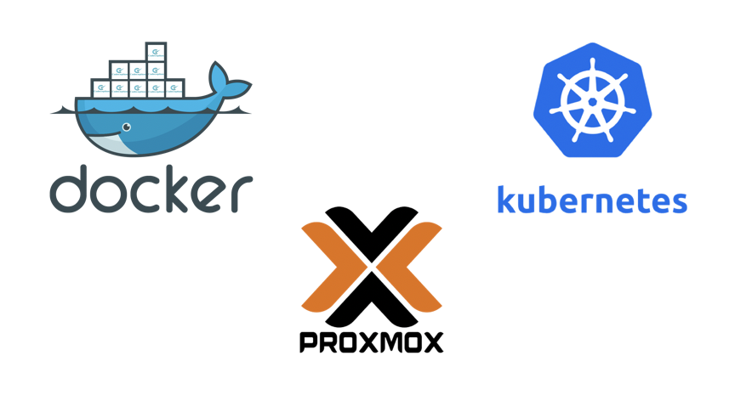
Presentation Focus

Slide 4
Presentation Focus

Slide 5
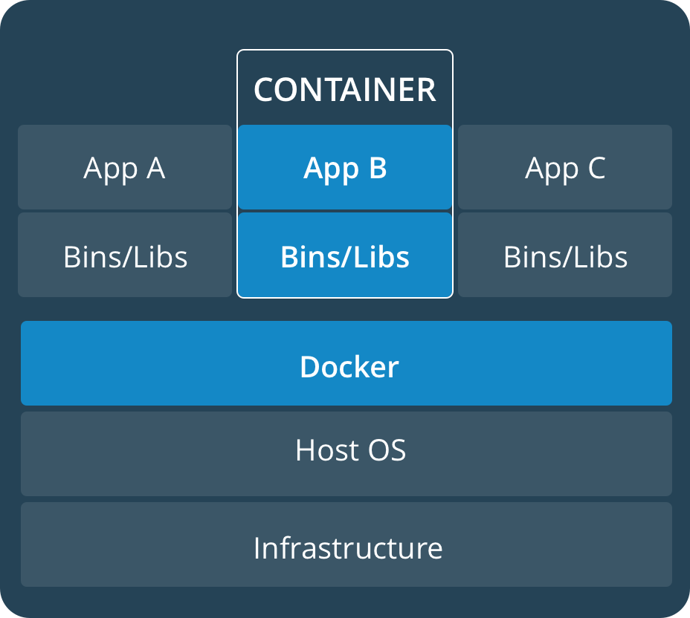
What is Docker?
Software used for virtualization
Allows for multiple Operating Systems to run on the same host
Unlike Hypervisors (used for VMs), virtualization is performed on system-level, inside isolated environments called containers
Containers
run on top of the host’s OS (among other containers)
handled like any other executable
launched by running an image (an executable package including everything necessary to run an application)

Slide 6
Installing Docker on Ubuntu
Setting up the Docker repository
Update the apt package index $ sudo apt-get update
Install packages to allow apt to use a repository over HTTPS $ sudo apt-get install apt-transport-https ca-certificates curl gnupg-agent software-properties-common
Add Docker’s official GPG key $ curl -fsSL https://download.docker.com/linux/ubuntu/gpg | sudo apt-key add -
Set up the stable repository on x86_64 / amd64 machine $ sudo add-apt-repository "deb [arch=amd64] \ https://download.docker.com/linux/ubuntu $(lsb_release -cs) stable"
Installing Docker Engine - Community
Update the apt package index $ sudo apt-get update
Install the latest version of Docker $ sudo apt-get install docker-ce docker-ce-cli containerd.io

Slide 7
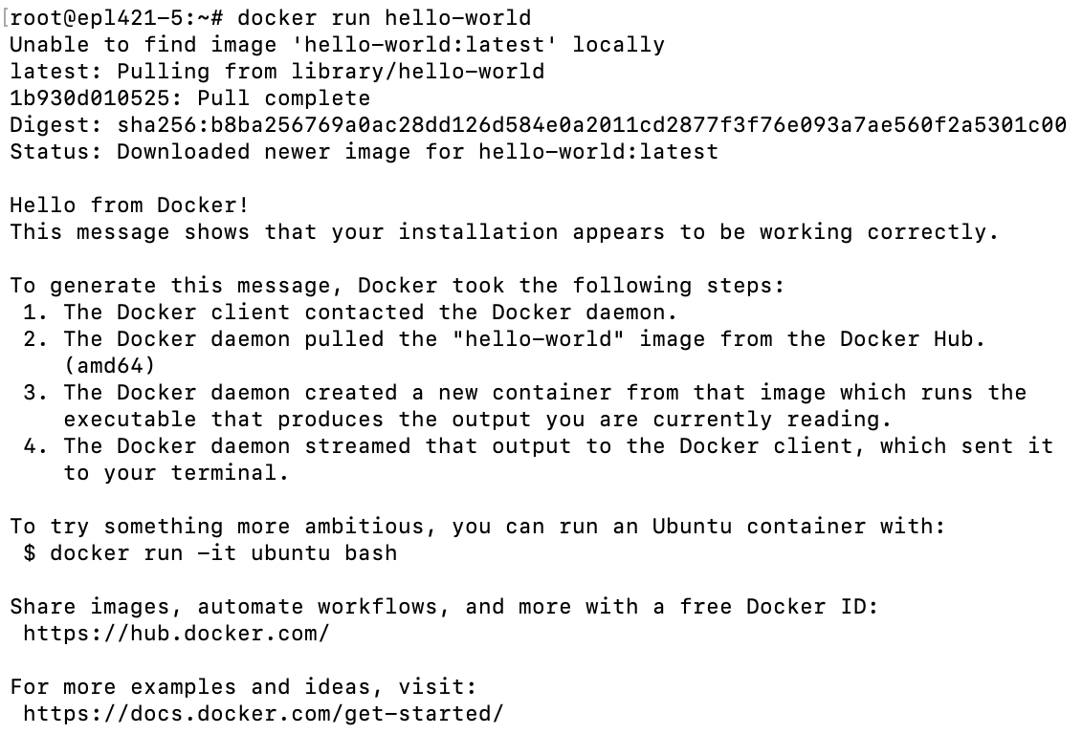
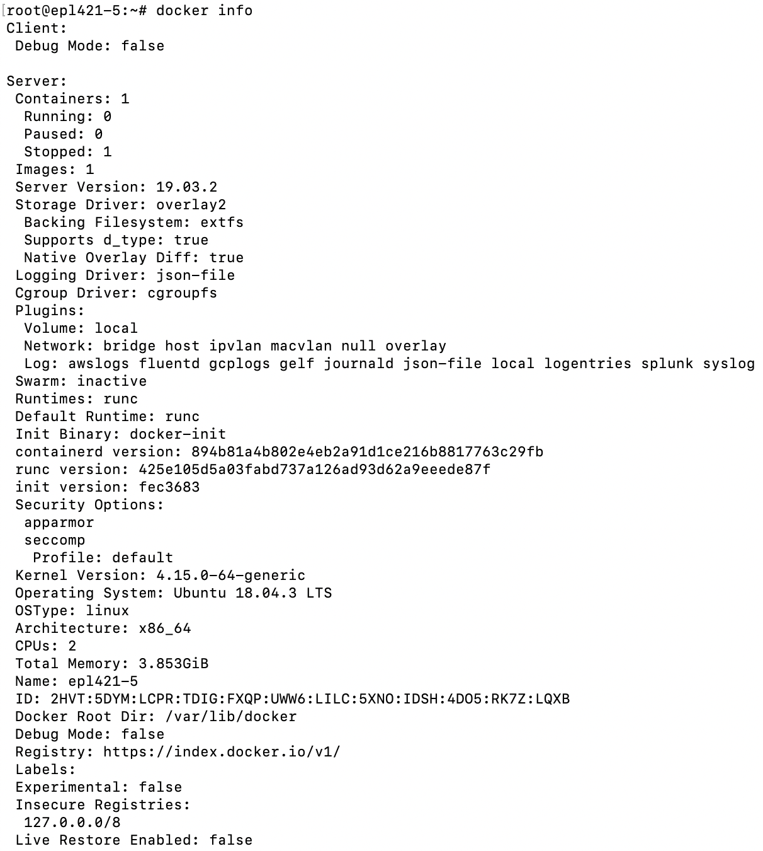
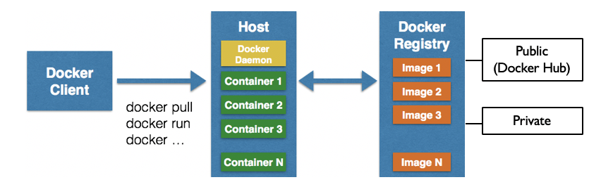
Running an image for the 1st time
1
2

Slide 8
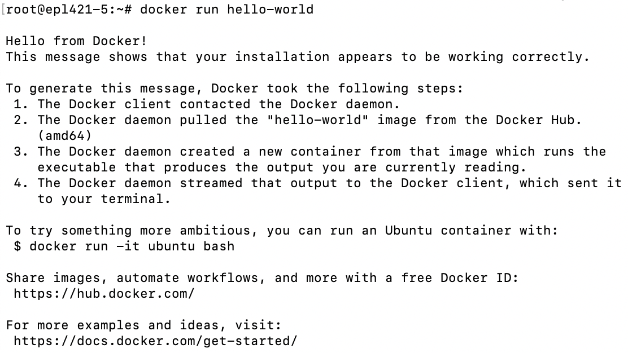

Running an image twice
1
ΝΟΤΕ
You can delete a container using ‘$docker rm containerID’ or an image using ‘$docker rmi imageID’, BUT you can never delete an image that is being used by a container, whatever its state.
2

Slide 9
A container’s lifecycle

Slide 10
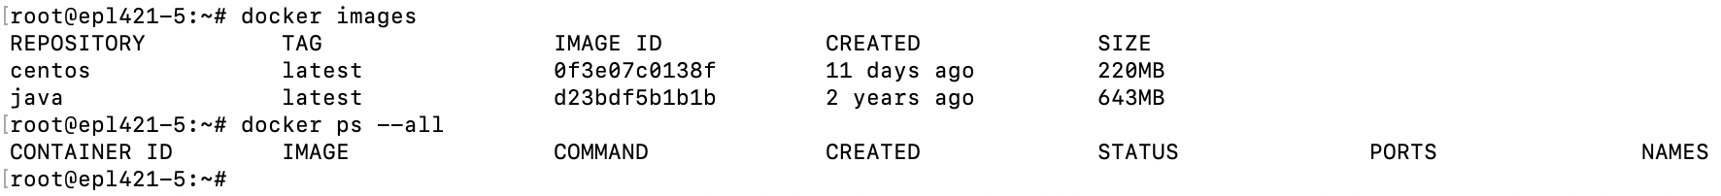
Start using Docker (1)
Obtaining an image:
($docker search Docker Hub and) $docker pull an image or a repository from a registry
$docker build an image from a Dockerfile
“A Dockerfile is a text document that contains all the commands a user could call on the command line to assemble an image.” ~Docker, Dockerfile Reference
$docker commit a container’s changes to create an image
$docker load an image from a tar achieve or STDIN
List images (same with $docker image ls)
List containers (same with $docker container ls)

Slide 11
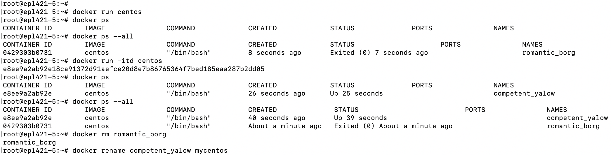
Start using Docker (2)
Running an instance of an image:
$docker run [OPTIONS] IMAGE
-p to specify ports in host and Docker container
-it to open up an interactive terminal after the container starts running
-e to set environmental variables
-d to start the container in daemon mode / run in the background […]

Slide 12
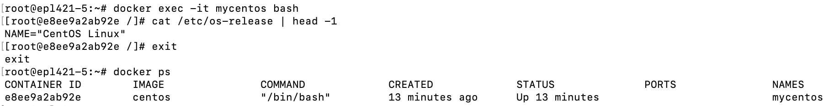
Start using Docker (3)
Handling a running container:
$docker exec [OPTIONS] CONTAINER COMMAND [ARGUMENTS]
$docker top all running processes of a container
$docker pause all running processes of a container
$docker unpause all running processes of a container
$docker stop one or more running containers
$docker start one or more stopped containers
$docker restart one or more containers
$docker kill one or more running containers
ΝΟΤΕ
To get the full list of Docker commands, just install Docker and on the command line type ‘$docker’.

Slide 13
Presentation Focus

Slide 14
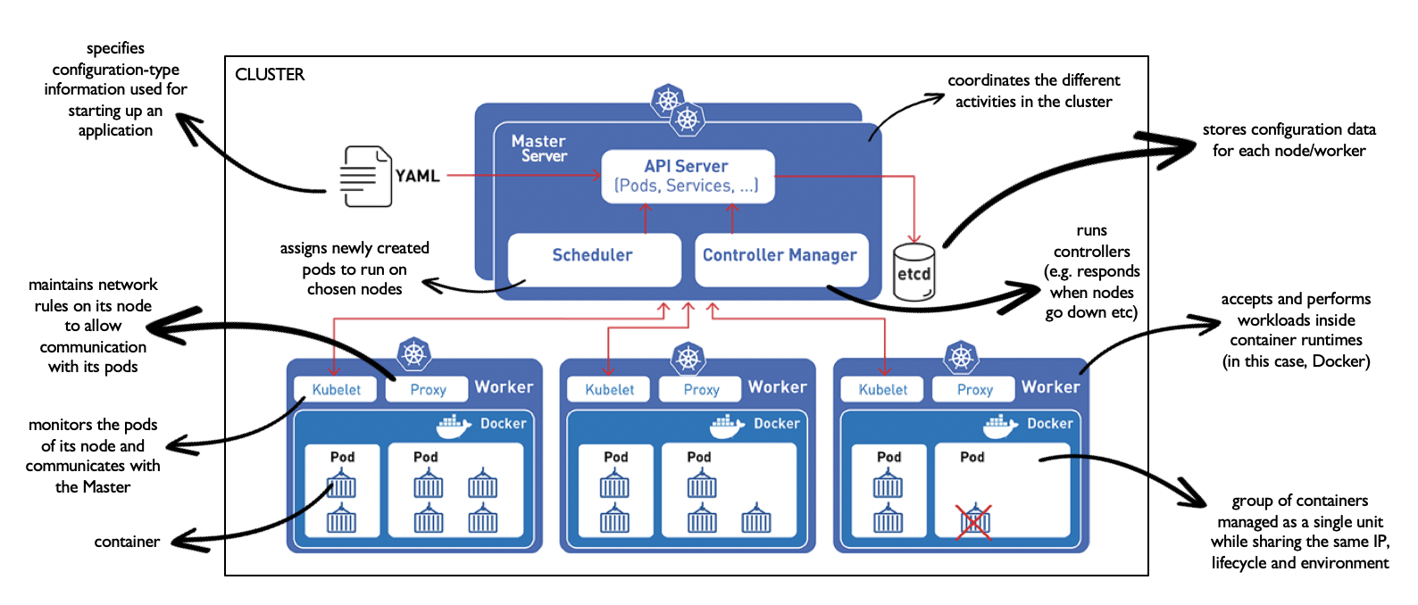
What is Kubernetes?
System for managing containerized applications in a clustered environment

Slide 15
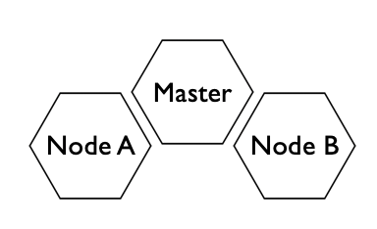
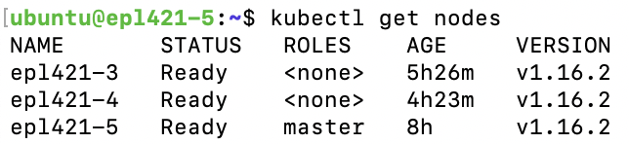
Creating a cluster
Enable Docker with $ sudo systemctl enable docker
Add Kubernetes signing key with $ curl -s https://packages.cloud.google.com/apt/doc/apt-key.gpg | sudo apt-key add
Add Xenial Kubernetes Repository with $ sudo apt-add-repository "deb http://apt.kubernetes.io/ kubernetes-xenial main"
Install kubeadm with $ sudo apt install kubeadm
Disable swap memory for Kubernetes to perform properly with $ sudo swapoff -a
Disable Firewall
Choose a pod network, e.g. Canal
Initialize Kubernetes using corresponding pod-network-cidr, e.g. $ sudo kubeadm init --pod-network-cidr=10.244.0.0/16
Follow the output instructions
Deploy pod network on the cluster, e.g. $ sudo kubectl apply -f https://docs.projectcalico.org/v3.8/manifests/canal.yaml
To join the cluster (as a worker node):
Follow steps 1-5
Execute $ kubeadm join command from Master initialization output

Slide 16
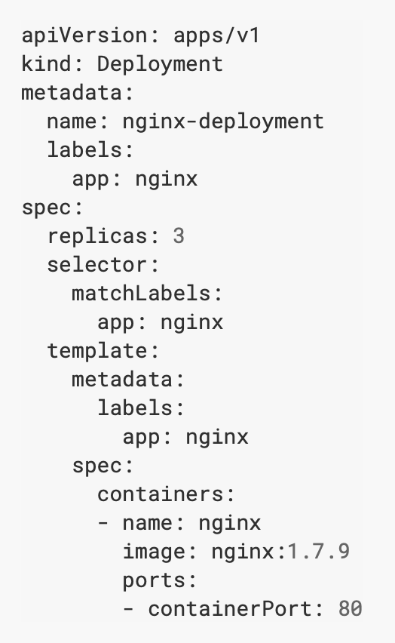
Creating Deployments
What is a Kubernetes Deployment?
mean to manage a pod’s lifecycle
describes the desired state of an application to ensure its availability
runs a set of multiple identical pods as replicas of an application to automatically replace crashed or unresponsive instances that deviate from the desired state of the app
Commands to create Deployments with
$ kubectl run an instance of an image (outputs “deployment.apps/<image> created”)
$ kubectl apply configuration (from .yaml or .json file or from stdin) to a resource
$ kubectl create a resource from given configuration (from .yaml or .json file or from stdin)

Slide 17
Inspecting Deployments
$ kubectl get deployments outputs a list of the cluster’s deployments carrying the following attributes
NAME of the deployment
DESIRED number of replicas
CURRENT number of running replicas
UP-TO-DATE number of replicas (replicas that have been updated to achieve the desired state)
AVAILABLE number of replicas to the users
AGE of the application (time since started running)
$ kubectl get rs outputs a list of the cluster’s replicas sets carrying the attributes
NAME of replica set
DESIRED number of replicas
CURRENT number of replicas
READY number of replicas
AGE of the application

Slide 20
Scaling Deployments
What is Kubernetes Scaling?
increase or decrease of the number of desired running replicas
$ kubectl scale <deployment> --replicas <y>, where y is the new number of desired replicas
Autoscaling Deployments
$ kubectl autoscale <deployment> --max <x> --min <y> --cpu-percent <z>, where x is the maximum number of desired replicas, y is the minimum number of desired replicas and z is the desired CPU utilization

Slide 21
Creating Services
What is a Kubernetes Service?
logical set of pods across one or more nodes sharing the same Service IP Address and performing a certain microservice
defined using a .yaml or .json file
Create a Service with $ kubectl apply -f <manifest_file>
View the specification of a created Service with $ kubectl get service -o yaml
5 types of Services
ClusterIP (default) → ensures a stable internal IP mapped to nodes even when their pods change
NodePort (extension of ClusterIP)
LoadBalancer (extension of NodePort)
ExternalName → provides external DNS name
Headless → no cluster IP allocation, no load balancing or proxying by the platform, direct interaction with the pods instead of a proxy

Slide 22
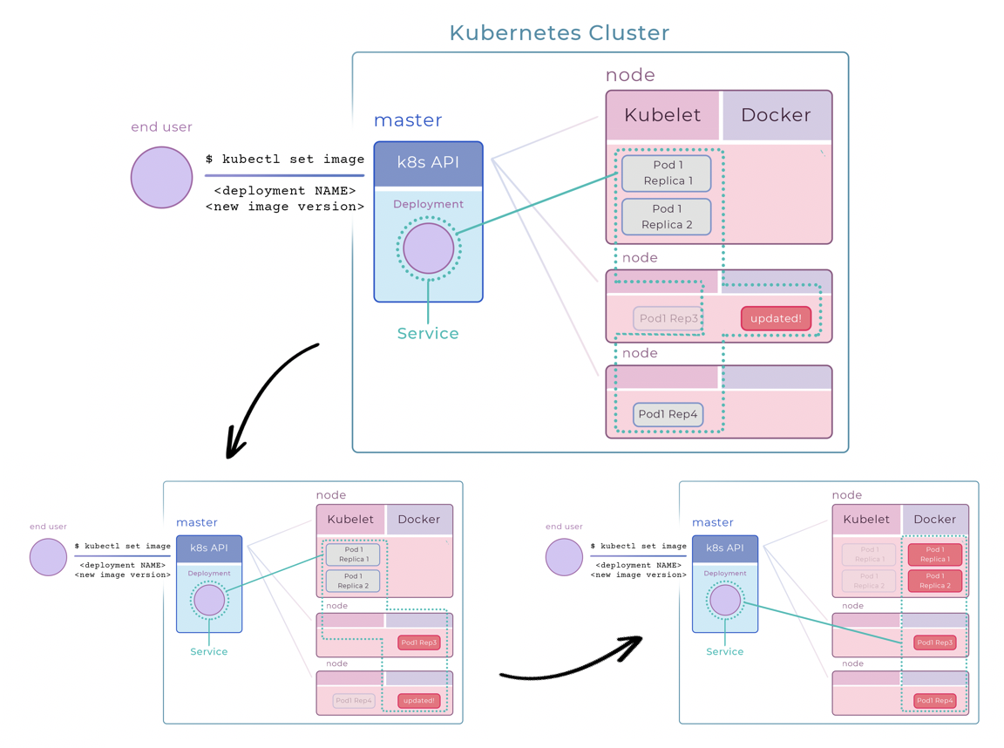
Rolling updates
ΝΟΤΕ
Roll back to a previous revision with ‘$kubectl rollout undo <deployment>’.
ΝΟΤΕ
To get the full list of kubectl agent commands, just install kubectl and on the command line type ‘$kubectl’.

Slide 23
Presentation Focus

Slide 24
What is Proxmox?
Debian-based Linux distribution with modified Ubuntu LTS kernels
Server virtualization environment for managing
Kernel-based Virtual Machines (KVMs)
hardware-assisted virtualization
provides device abstraction but no processor emulation by exposing the /dev/kvm interface
Linux Containers (LXCs)
operating-system level virtualization
allows for multiple isolated Linux systems instances to run on a single host using a single Linux kernel

Slide 25
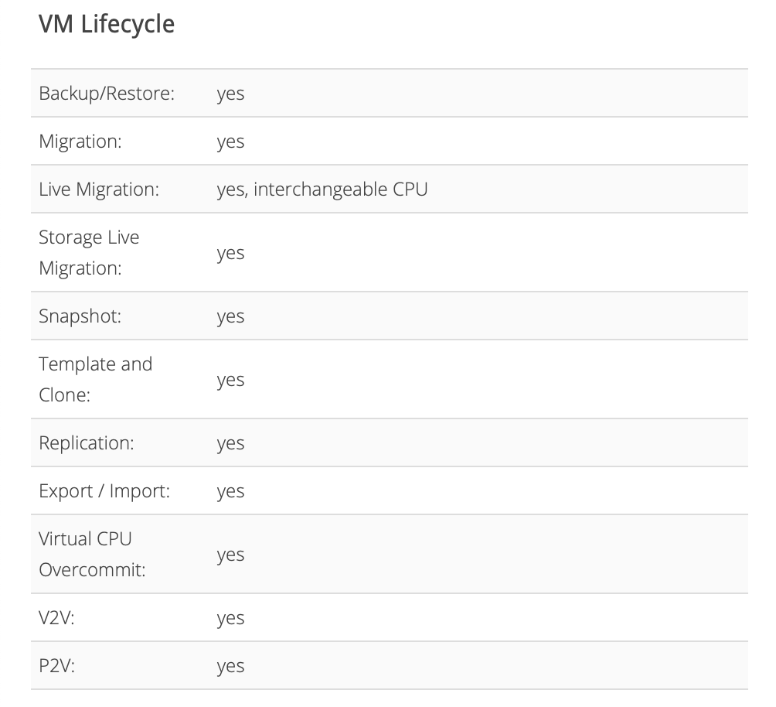
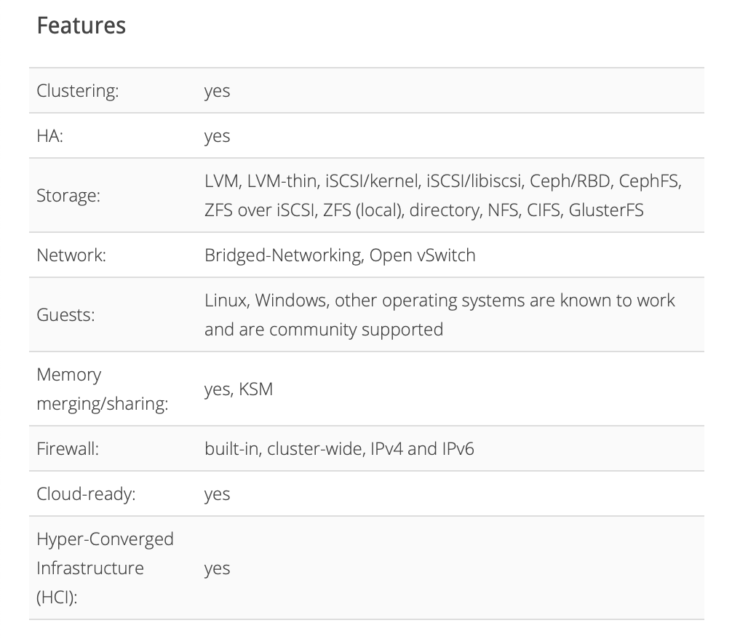

Slide 26
References
https://searchcloudcomputing.techtarget.com/definition/Platform-as-a-Service-PaaS
https://docs.docker.com
https://kubernetes.io/docs
https://www.proxmox.com/en

